Slide 1
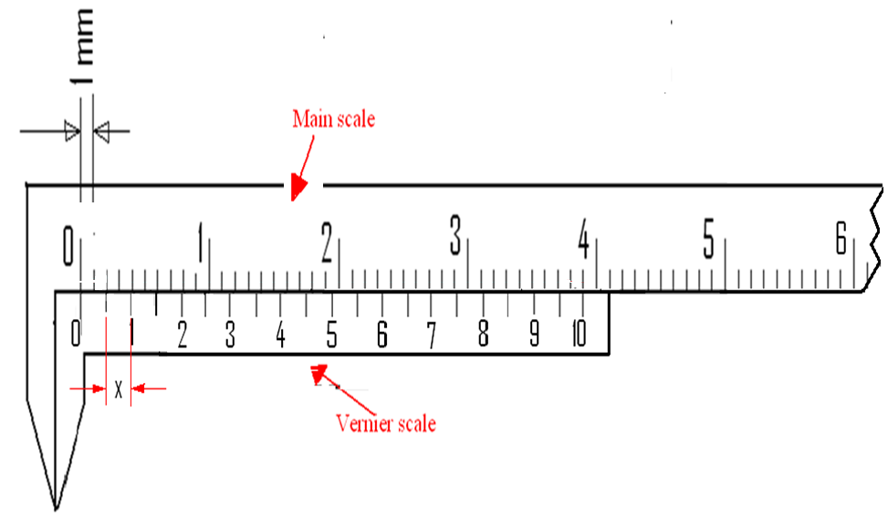
Measuring length with slide calipers

Slide 2
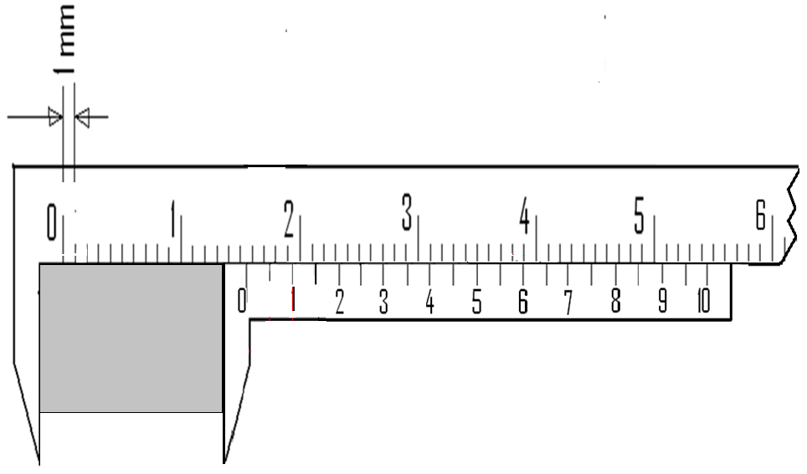
Measuring length with slide calipers

Slide 3
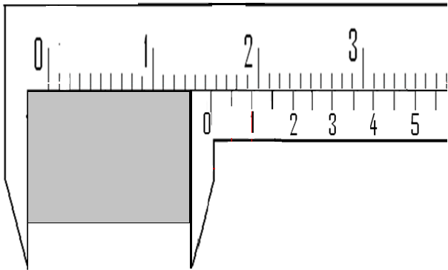
Measuring length with slide calipers

Slide 4
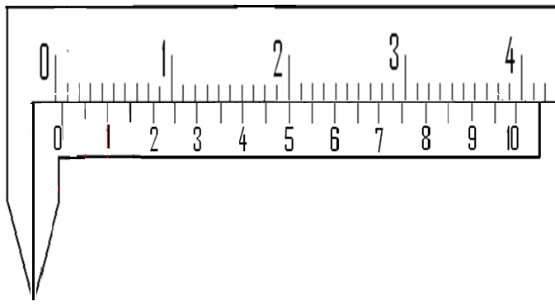
Measuring length with slide calipers

Slide 5
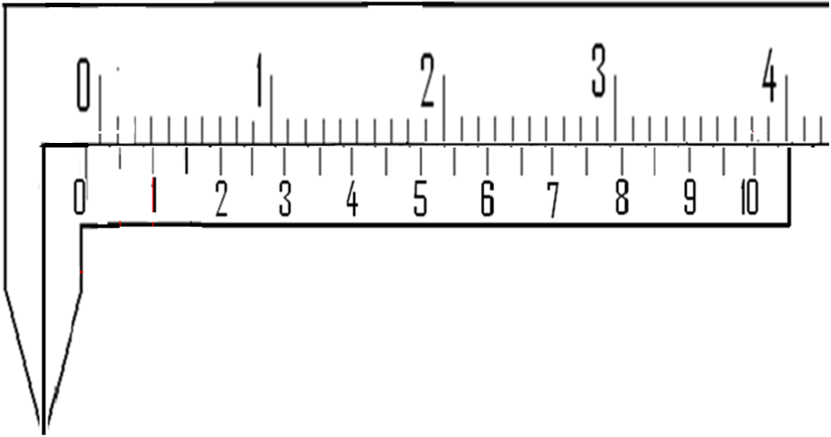
Measuring length with slide calipers

